Slide 1
Cover Letters & Résumés

Slide 2
Objectives
To describe the importance of correctly formatted cover letters and résumés.
To illustrate the necessary steps in developing cover letters and résumés.
To recommend guidelines for constructing cover letters and résumés.

Slide 3
Main Menu
Cover Letters
Résumés

Slide 4
Cover Letters

Slide 5
Cover Letters
Are written to a potential employer and accompany a résumé
Are also called a letter of application
Make a first impression on employers
Provide a brief summary of what can be contributed to the potential employer
Allow the interviewer to see a glimpse of your written communication skills

Slide 6
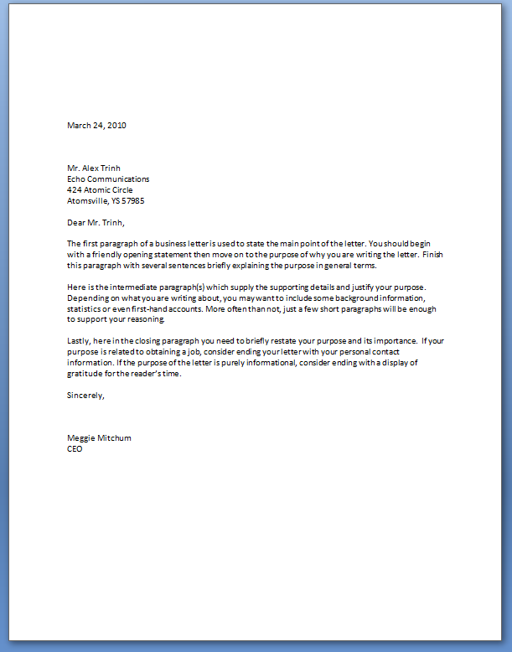
Cover Letters
Prepare the employer for the information provided in the résumé
Should be modified for each specific position
Need to be addressed to the specific employer in business letter format
Are equivalent to a personal sales pitch

Slide 7
Cover Letter
Include:
date
prospective employer’s name and address
three to five paragraphs
signature and typed named

Slide 8
First Paragraph
Explains the reason for writing and position for which the applicant is applying
Needs to draw the employer’s interest by:
praising the company
mentioning a mutual contact if there is one
referencing the placement of the job posting

Slide 9
First Paragraph
Example:
I recently read an article in The Quarter Horse Journal® which praised Anderson Bean Boot Company® on their hand-crafted, fine quality boots. This article interested me in the part-time position as an assistant customer service representative.

Slide 10
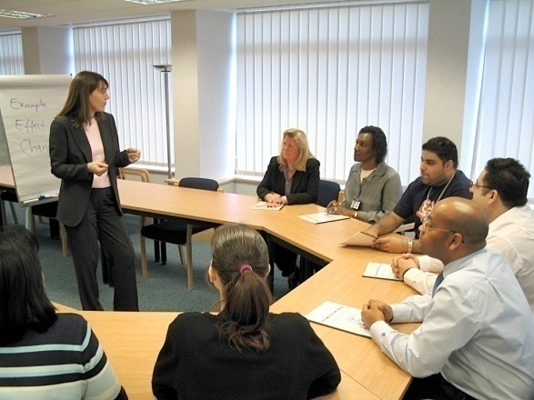
Middle Paragraphs
Indicate how you can meet an employer’s particular needs using two to three qualifications
Describe why you are interested in the company
Illustrate your experience and training in the field

Slide 11
Middle Paragraphs
Example:
For the past two years, I have worked in the boot industry as a cashier and customer service representative. I have excellent communication skills and a talent for aiding customers. This experience has enabled me to answer questions promptly, develop great communication skills and provided me with an in-depth knowledge of the boot industry. I believe I can be an asset to the company with my level of expertise and familiarity of the product.

Slide 12
Closing Paragraph
Requests an interview at the employer’s convenience
Informs the employer you will call for his or her reaction to the résumé
Refers the employer to the enclosed résumé

Slide 13
Closing Paragraph
Example:
My résumé is enclosed and I will call during the next week to arrange an interview. Thank you for your consideration.

Slide 14
Résumés

Slide 15
Résumé
Is a synopsis of personal information, education, skills, work experience and activities
Outlines a person’s qualifications
Reflects a person’s individual credentials
May be arranged in three ways:
chronological
targeted
function oriented

Slide 16
Chronological Résumés
Focus on a stable work history
Show jobs held in a sequential order
Present the most recent employment first

Slide 17
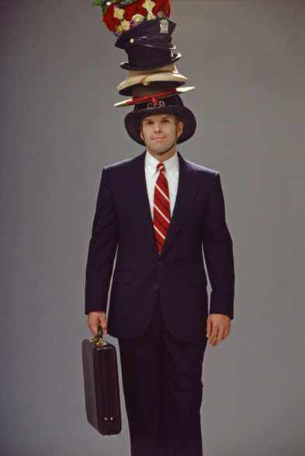
Targeted Résumés
Accentuate responsibilities and capabilities of particular positions held
Emphasize past experience
May de-emphasize the most recent job if not relevant to the current job pursuit

Slide 18
Function Oriented Résumés
Emphasize the applicant’s overall capabilities
Demonstrate skills obtained through study
Should be used when one has limited actual work experience or inconsistent work history

Slide 19
Parts of a Résumé
Contact information
Objective
Education
Work experience
Community involvement or volunteer activities
References

Slide 20
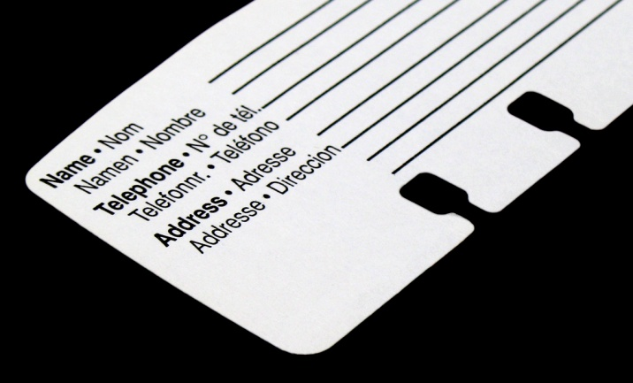
Contact Information
Should be displayed at the top of the first page and include:
name
address
phone number(s)
e-mail address

Slide 21
Objectives
Outline a brief description of the desired position
Will be different for every application
Examples:
Objective: To obtain a position as a Business Development Associate with a pharmaceutical company with an opportunity to develop new territories and marketing programs.
Objective: To obtain a part-time position at Mesa Country Club assisting the pro-shop manager.

Slide 22
Work Experience
Lists a brief description of the job responsibilities
Should include all companies’ names, locations, dates and job titles
Outline specific achievements and job responsibilities

Slide 23
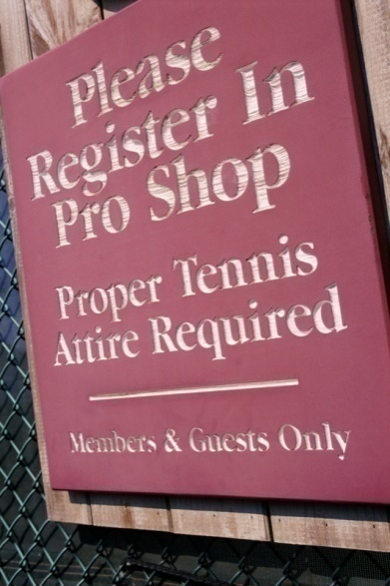
Work Experience
Examples:
2007-Present: Vista Country Club, Houston, Texas
supervise pro-shop
organize inventory
communicate with customers
operate telephones switchboard
I work as a representative for the country club by supervising the pro-shop, answering phones and resolving questions.

Slide 24
Education
Includes most recent level of completion or current status
Lists institutions chronologically starting with the most recent
Lists names, locations, dates and degrees from all secondary and post-secondary institutions attended
Includes grade point average, awards, projects, reports and extracurricular activities

Slide 25
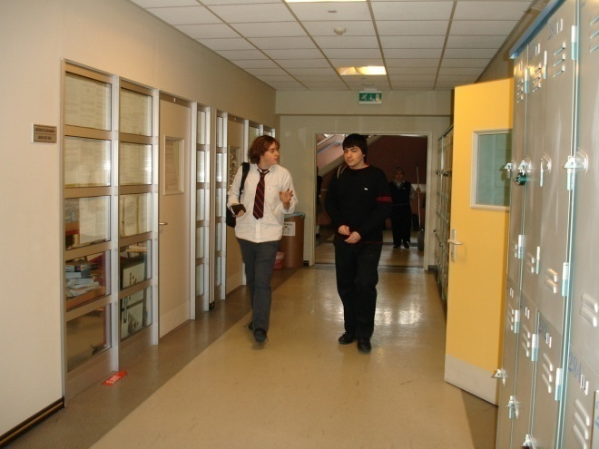
Education
Example:
Tyler High School Tyler, TX Fall 2004-present
High School Diploma
GPA: 3.81

Slide 26
Activities & Honors
Who’s Who Among America’s High School Students
Student Council
National Honor Society
Peer Assistance Leadership
Football Team Captain

Slide 27
Community Involvement or Volunteer Activities
Highlight community, student and professional activities
Shows human interest and ability to manage multiple tasks
Should include:
organization offices
volunteer endeavors
school extracurricular activities
leadership positions

Slide 28
Projects, Publications & Presentations
If applicable, list publications and presentations
for example:
published book or paper
presentation or paper
community or school projects

Slide 29
References
Are individuals who can attest to your abilities and character
Tips:
provide two to four references, both male and female
previous employers
teachers
community leaders
call before placing information on résumé to ensure availability
do not use family members as a reference

Slide 30
Templates
Are a preset form offered by various word processing programs
Can be useful for entry level job seekers
Should be modified to fit specific needs
Can help with spacing and organization

Slide 31
Résumé Tips
First impressions count
Make sure all words are spelled correctly
Correct all punctuation errors
Keep organized and neat
Do not abbreviate or use contractions
Type a cover letter and résumé in black ink on white paper
résumé paper is available but not required
Use appropriate amount of white space

Slide 32
Résumé Tips
Use powerful verbs
achieved
organized
implemented
supervised
Use consistent indenting to arrange key block of information
all dates should line up under one another on a margin

Slide 33
Résumé Tips
Emphasize skills but do not misrepresent the truth
Keep résumé to two pages or less
Attach references on a separate page
Avoid overusing adjectives, such as:
top-producing
inventive
hands-on

Slide 34
Résumé Tips
Do not include personal information such as:
age
sex
weight
pictures
marital status

